Slide 1
EPL PROJECT
By: Bearded Monkeys

Slide 2
WHAT ARE THE PROBLEMS WITH THE CURRENT SYSTEM ?

Slide 3
PROBLEM
Tickets are automatically created by email, not created by the user

Slide 4
SOLUTION
User creates ticket which is directly entered into the database, cutting out the e-mail middleman

Slide 5
PROBLEM
Tickets cannot be edited or cancelled
Lacking Critical Information

Slide 6
SOLUTION
The user having direct access to the ticket allows them to alter the ticket information as necessary
System ensures that all critical information is entered before the ticket is submitted

Slide 7
PROBLEM
Multiple users submit tickets for the same issue

Slide 8
SOLUTION
System allows users to see the tickets that others have submitted, letting them see whether their issue has already been asked or answered

Slide 9
PROBLEM
Users cannot track the progress of their tickets

Slide 10
SOLUTION
System presents all of the user’s currently open tickets, including whether they are currently being worked on or have been solved

Slide 11
MOCKUP

Slide 12
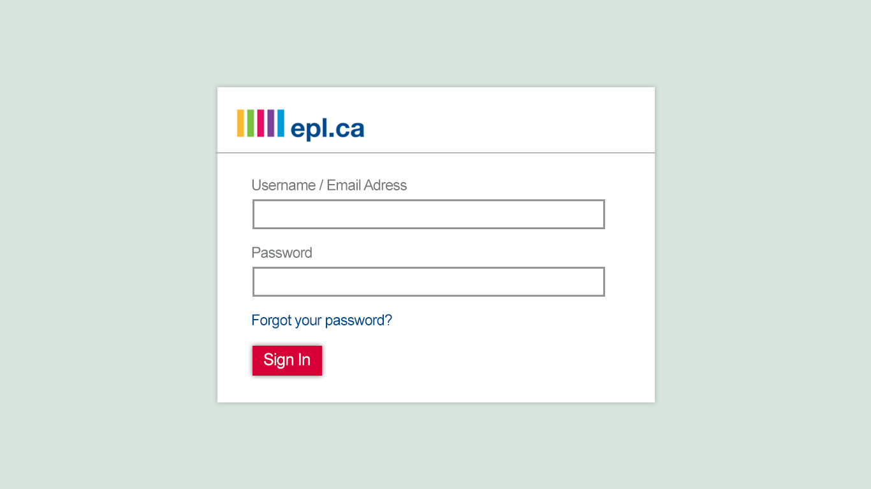
MARK UP

Slide 13
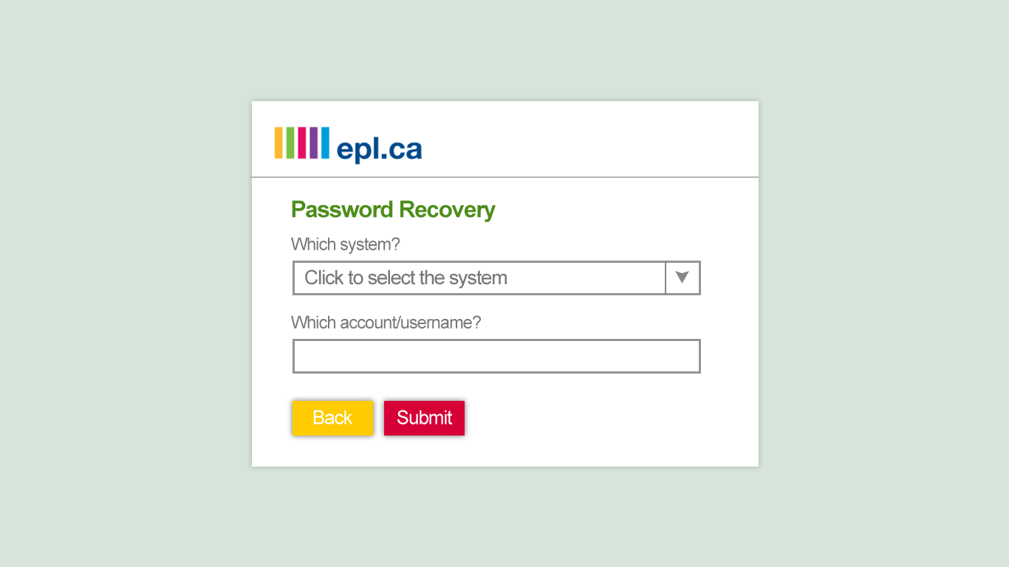
MARK UP

Slide 14
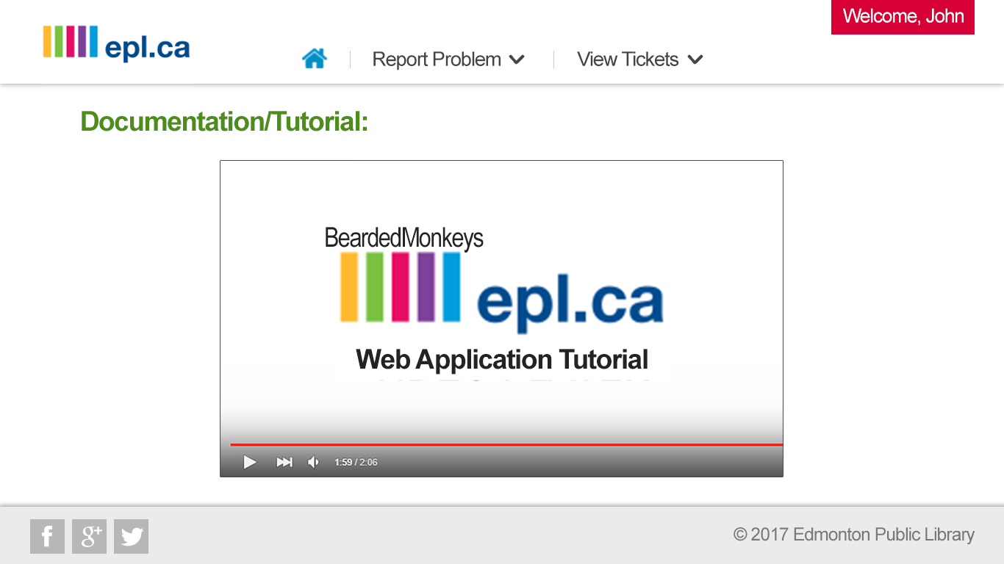
MARK UP

Slide 15
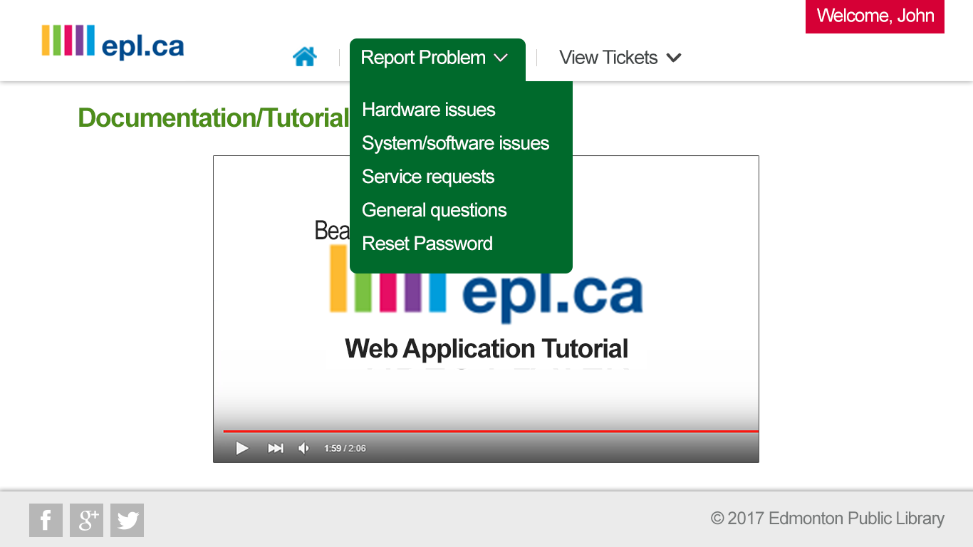
MARK UP

Slide 16
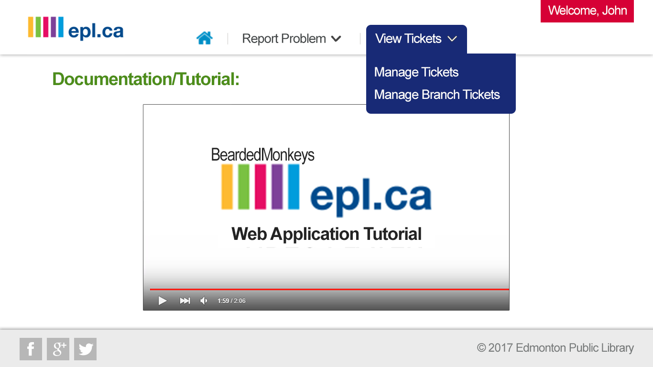
MARK UP

Slide 17
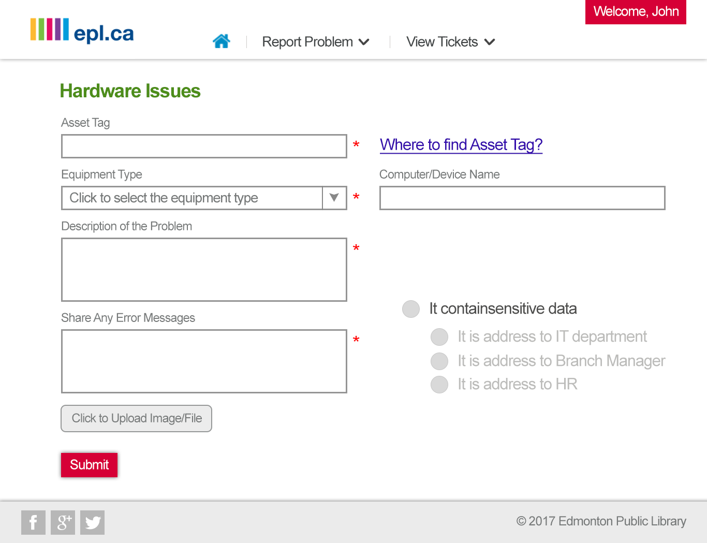

Slide 18
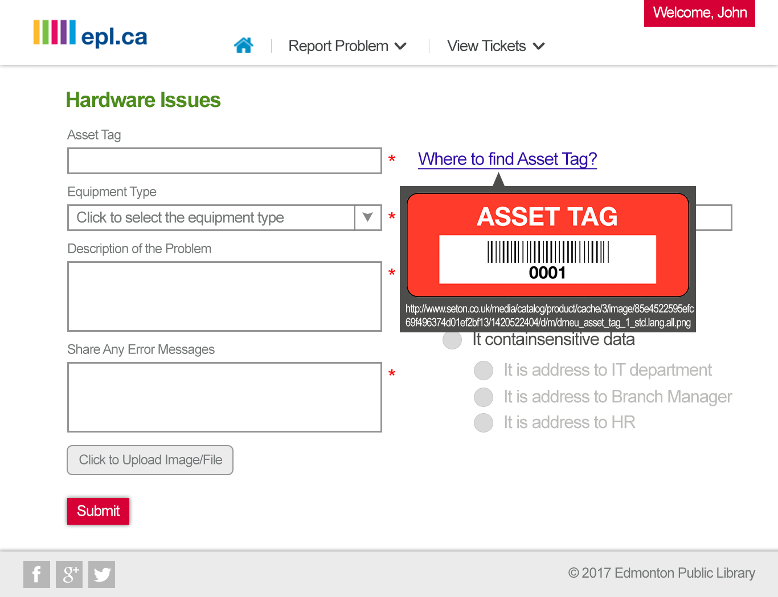

Slide 19
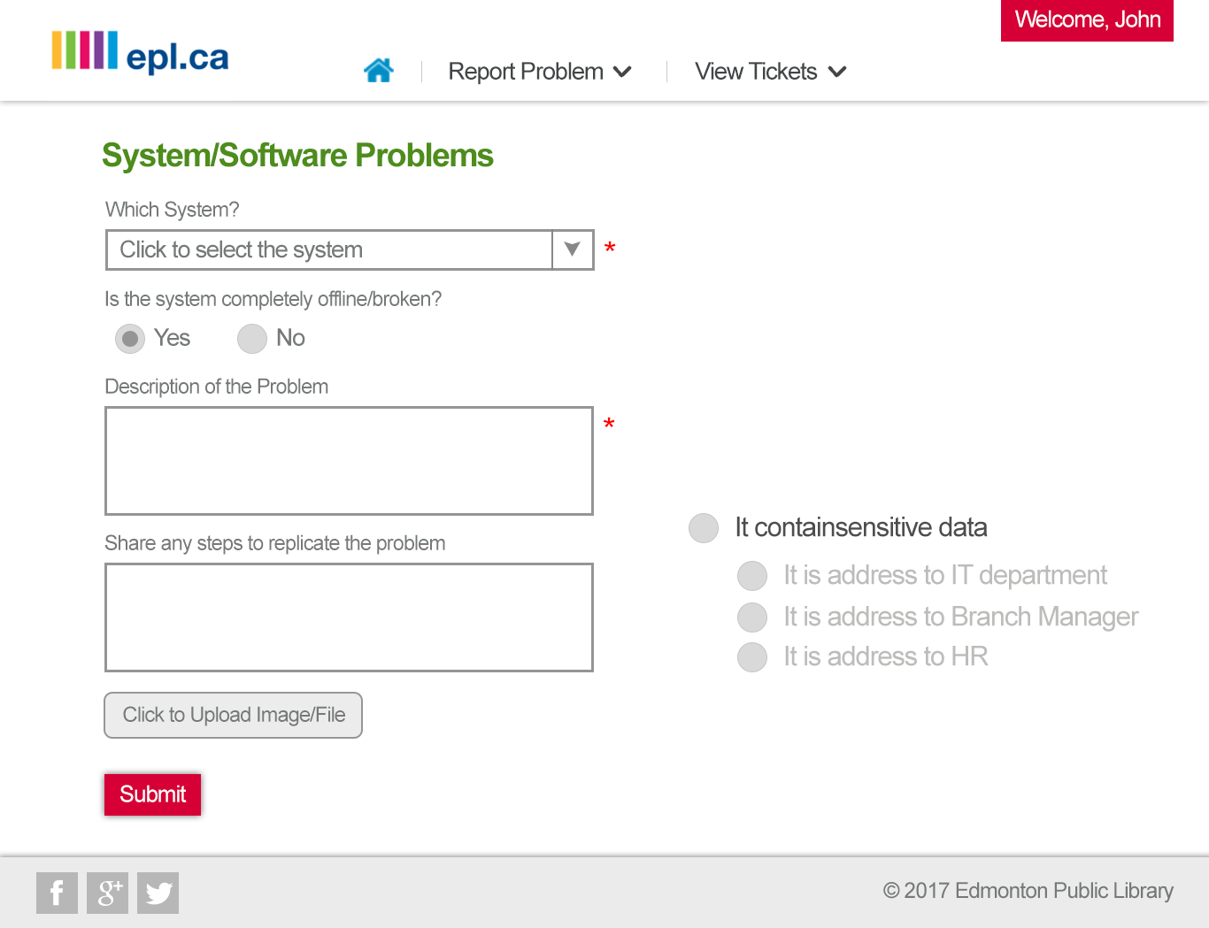

Slide 20
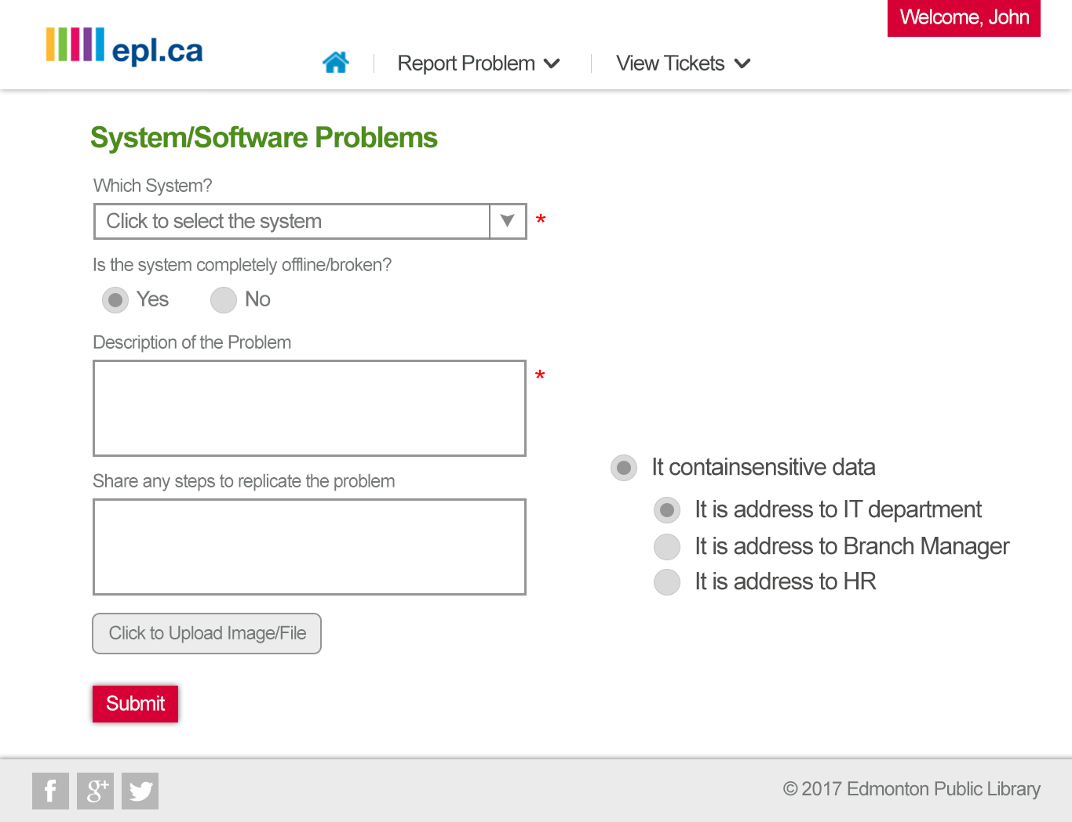

Slide 21
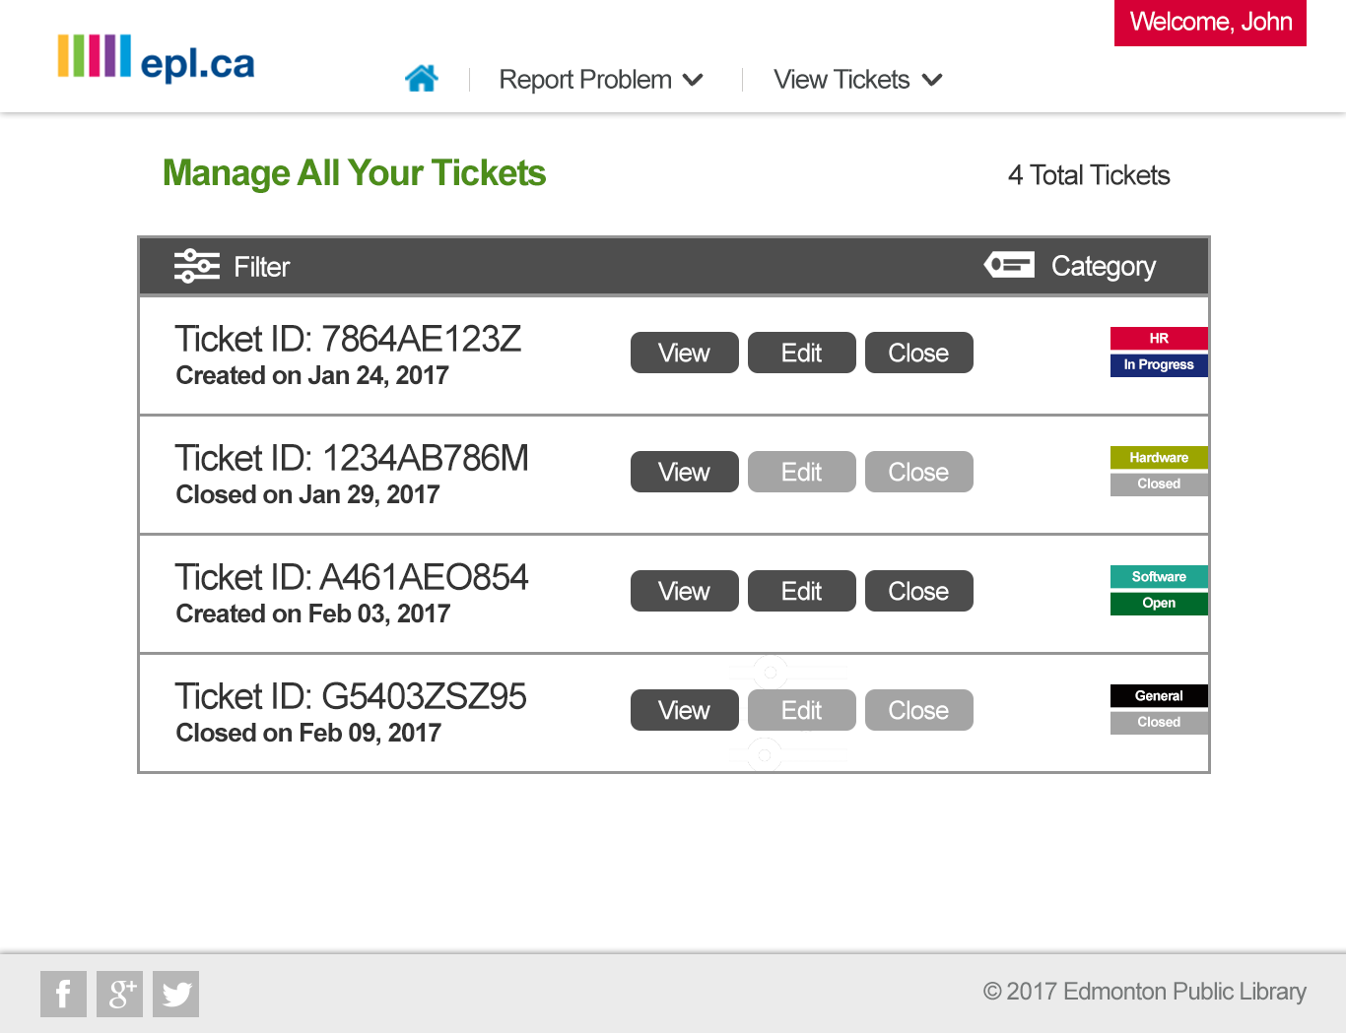

Slide 22
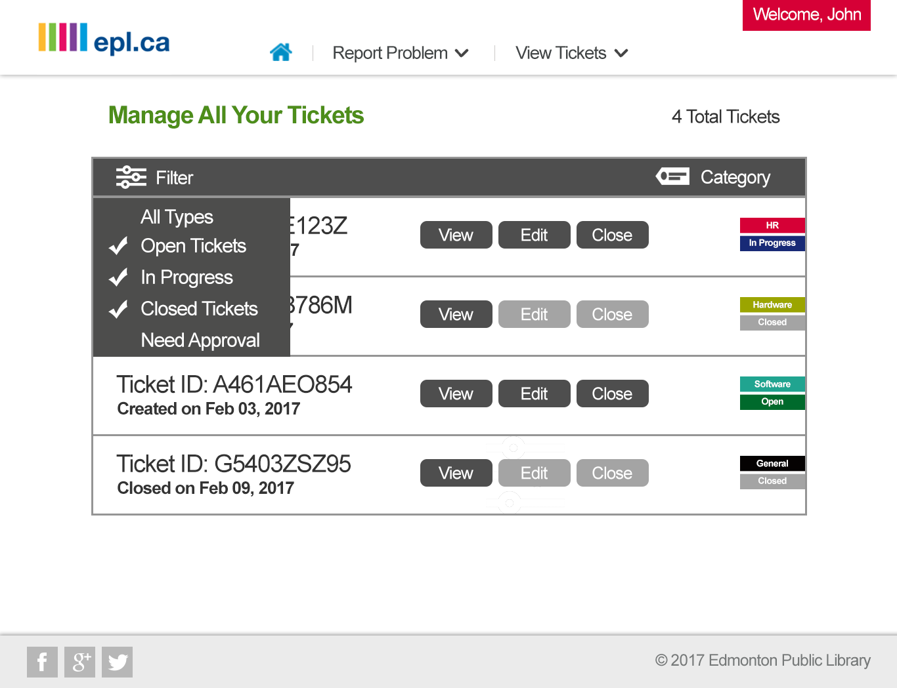

Slide 23
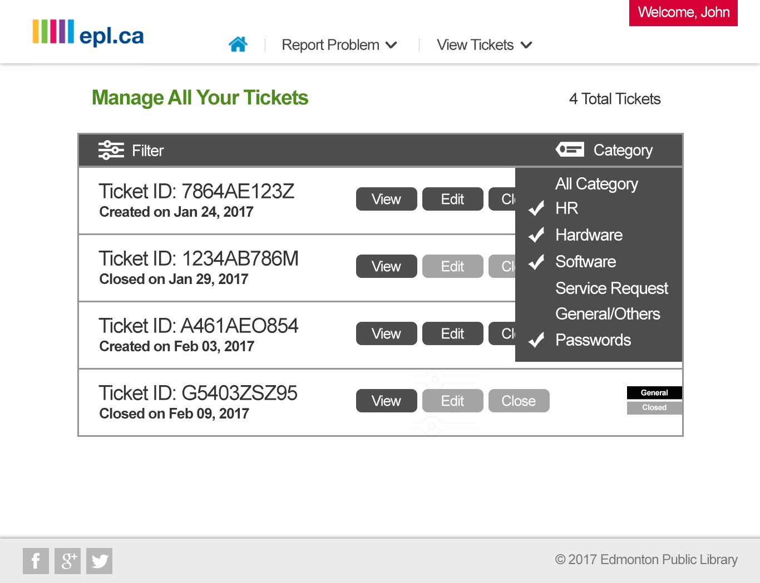

Slide 24
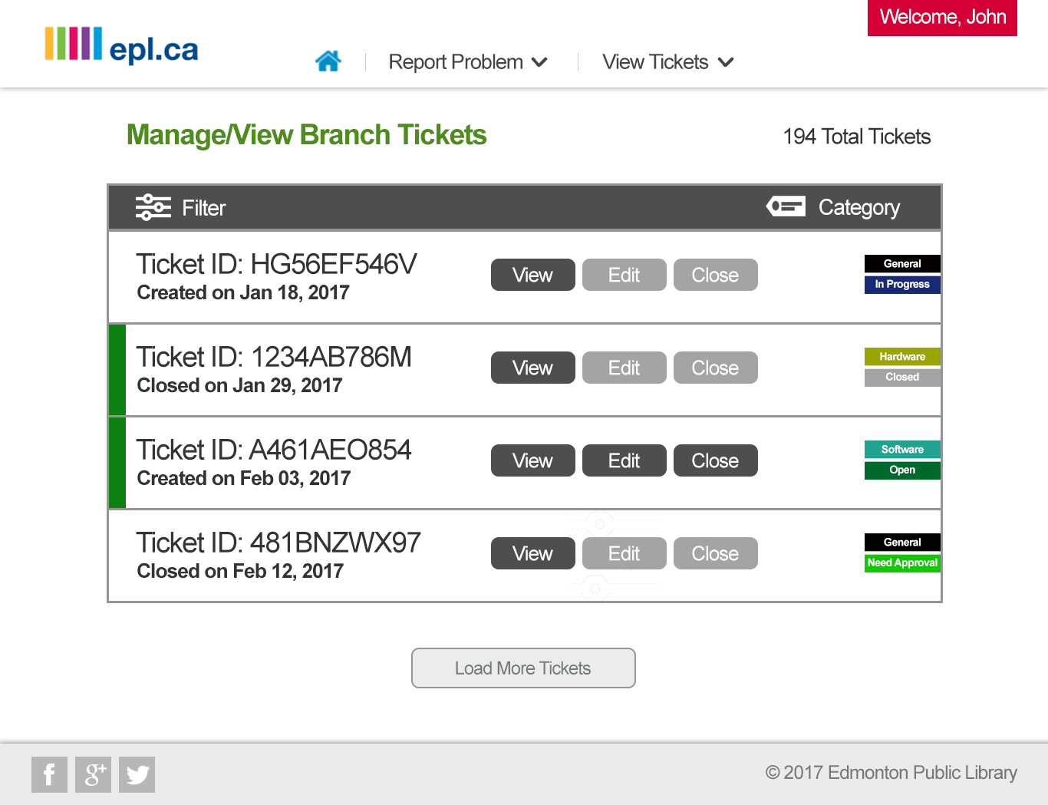

Slide 25
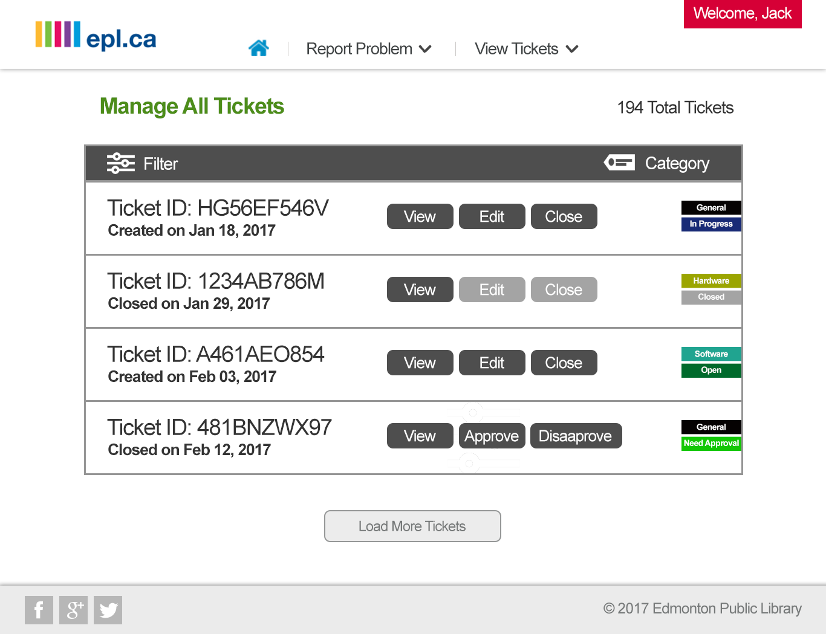

Slide 26
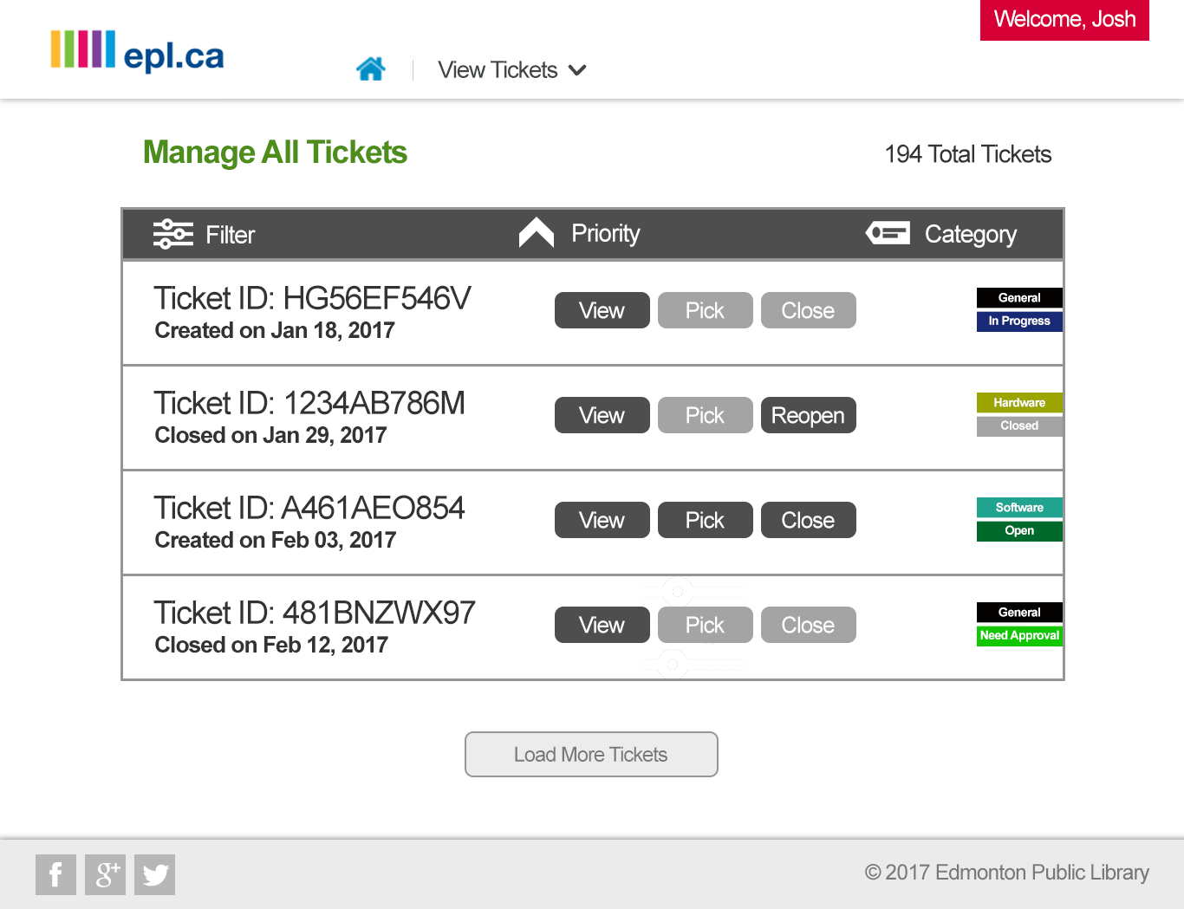

Slide 27
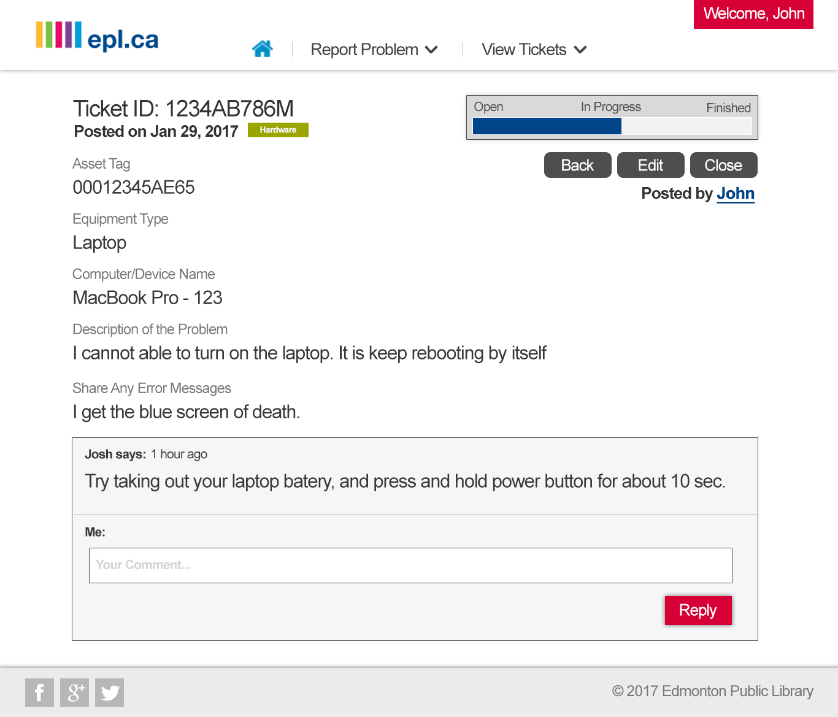

Slide 28
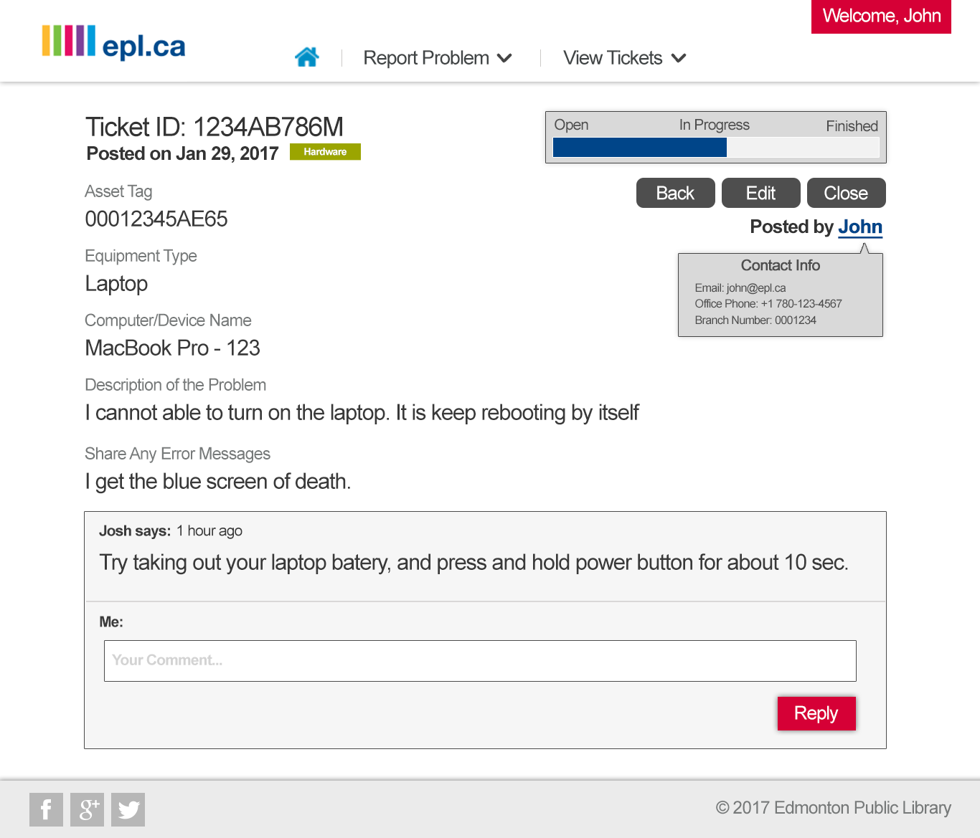

Slide 29
USER STORIES

Slide 30
USER STORY
As a user I want to reset my password so that I can access my account

Slide 31
MARK UP

Slide 32
MARK UP

Slide 33
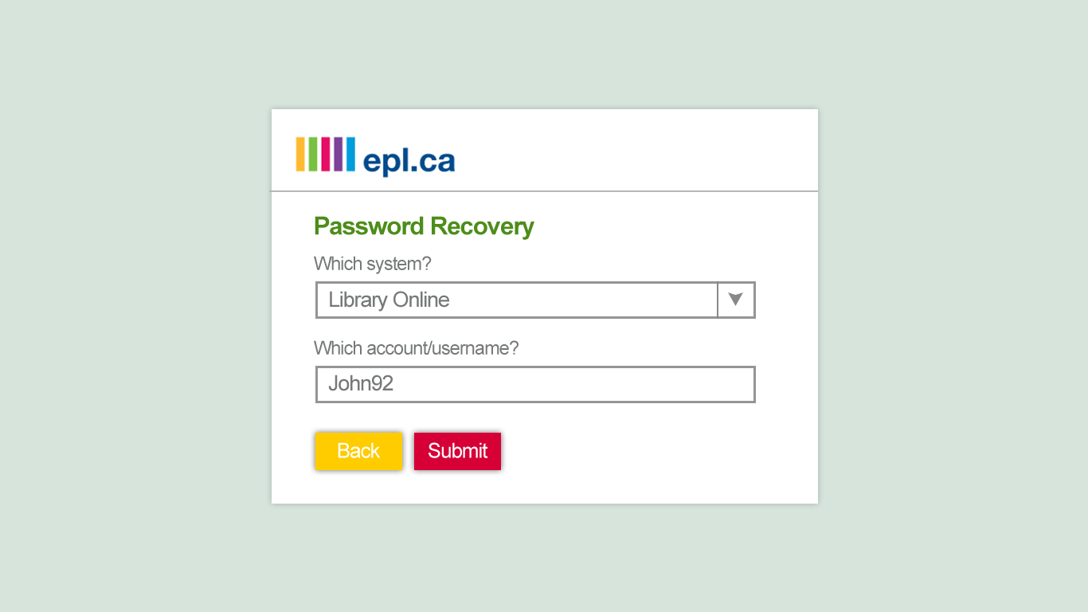
MARK UP

Slide 34
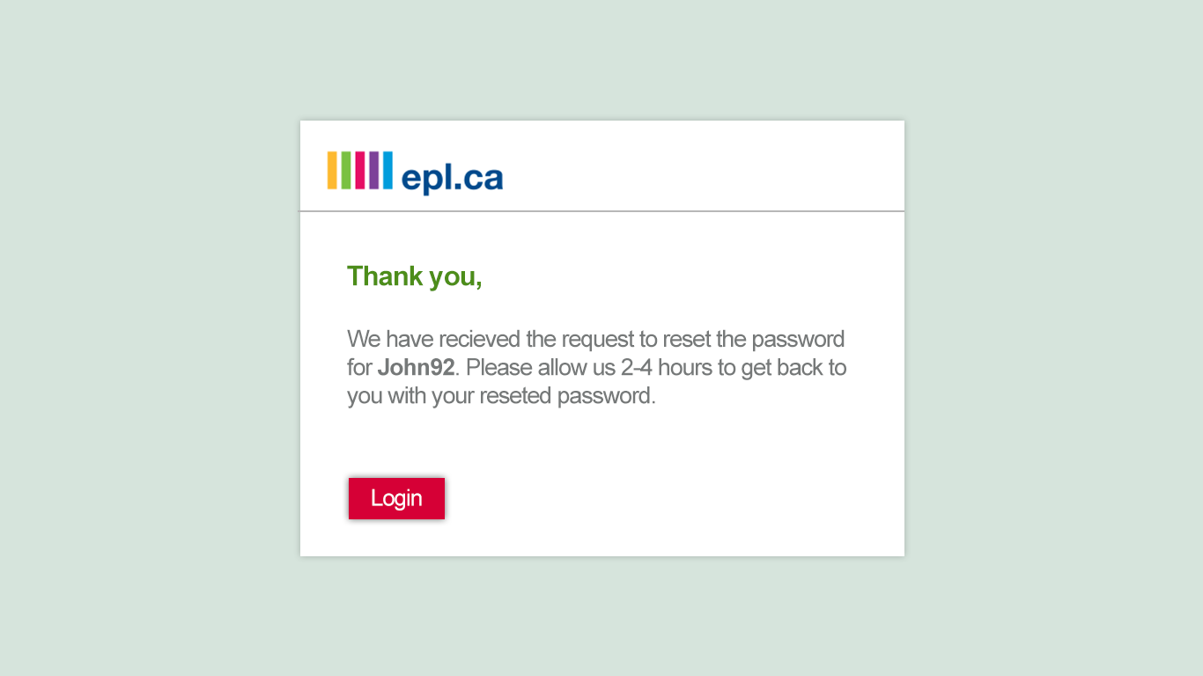
MARK UP

Slide 35
USER STORY
As a user I want to report a hardware problem so that it can be worked on

Slide 36
MARK UP

Slide 38
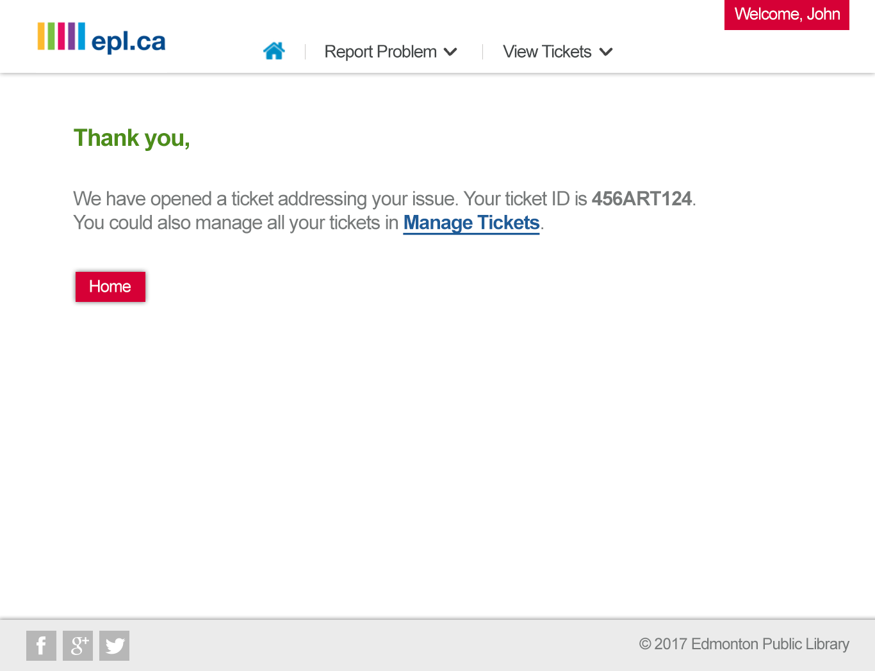

Slide 39
USER STORY
As a user I want to close a ticket I’ve made so that it can’t be worked on

Slide 40
MARK UP

Slide 42
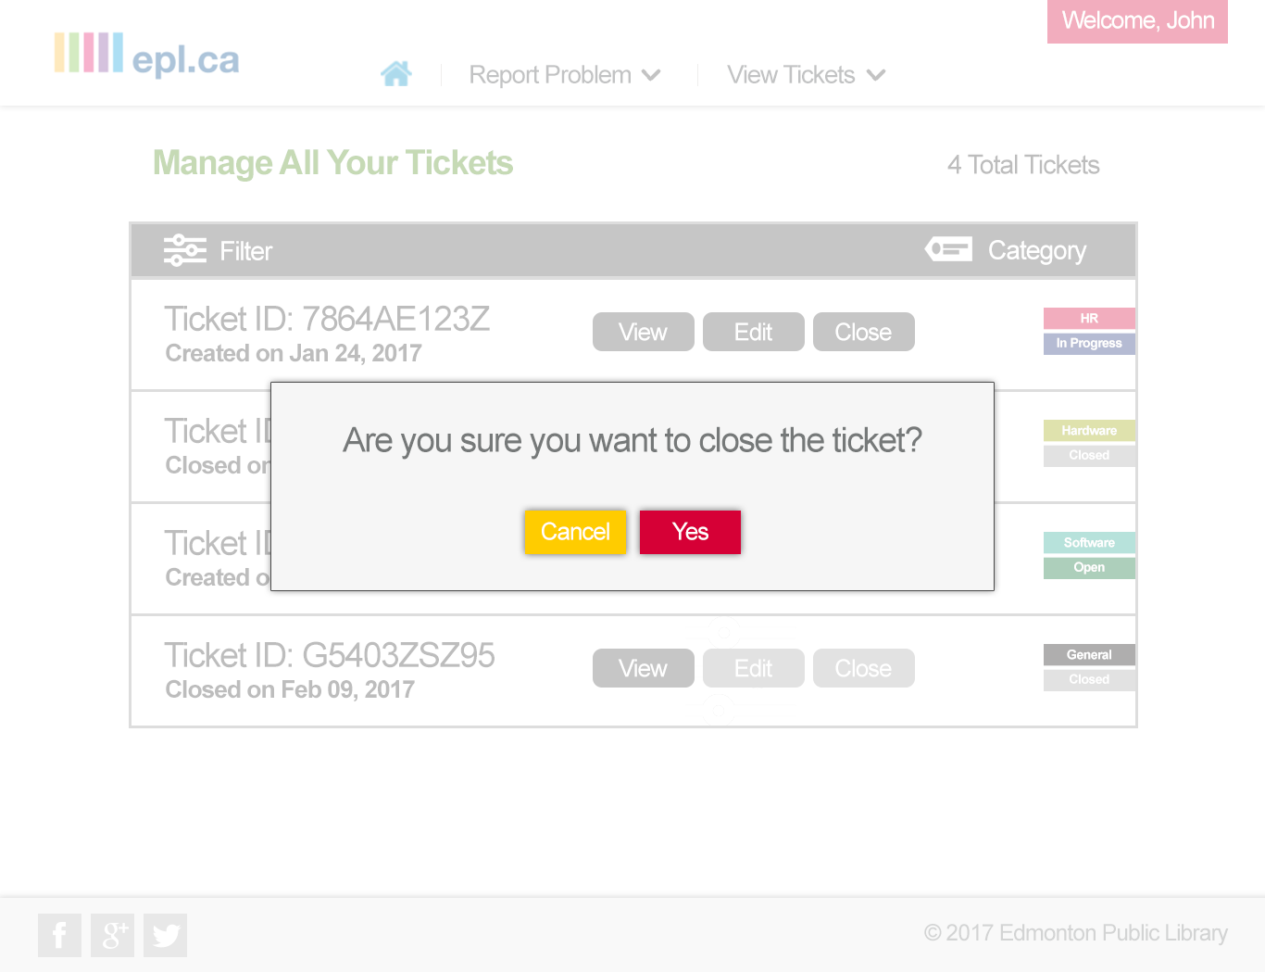

Slide 43
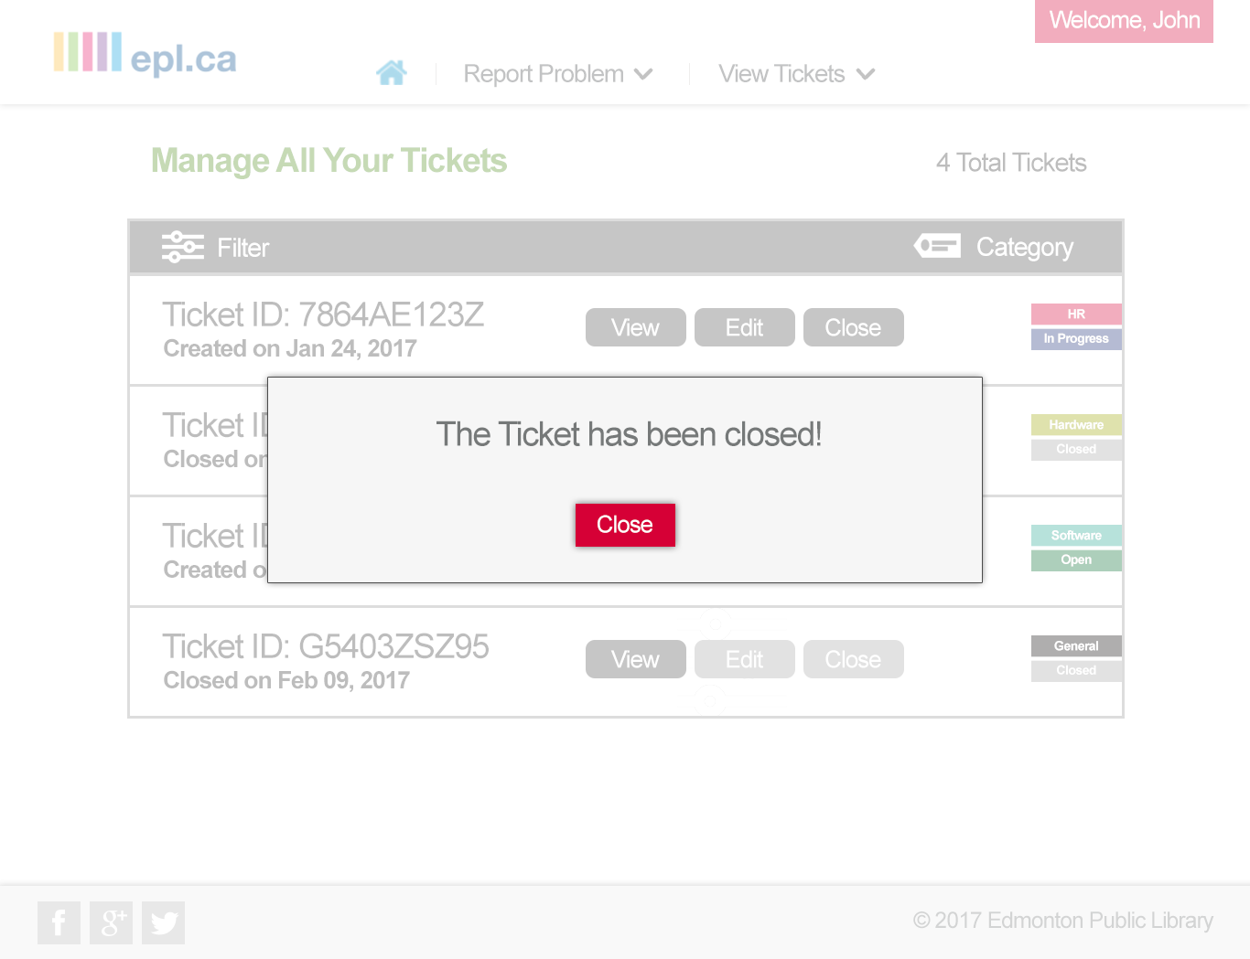

Slide 44
USER STORY
As an IT Staffer I want to see only open tickets so that I know which tickets I can work on

Slide 45
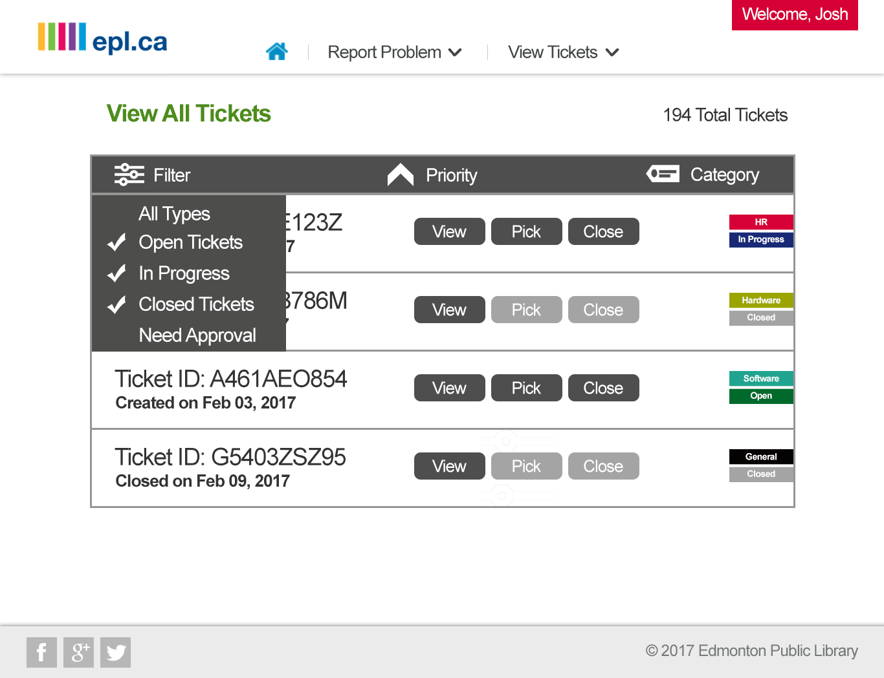

Slide 46


Slide 47
USER STORY
As a branch manager, I want to approve a ticket made in my branch so that it can be worked on

Slide 48
MARK UP

Slide 49
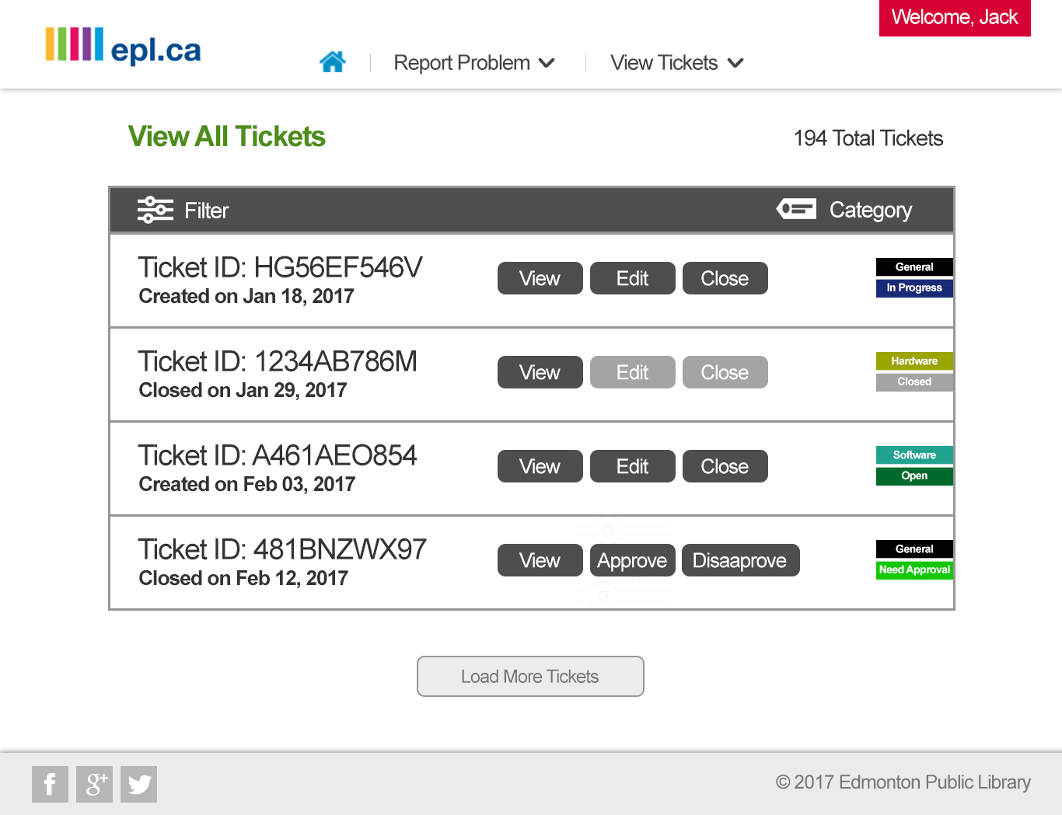

Slide 50
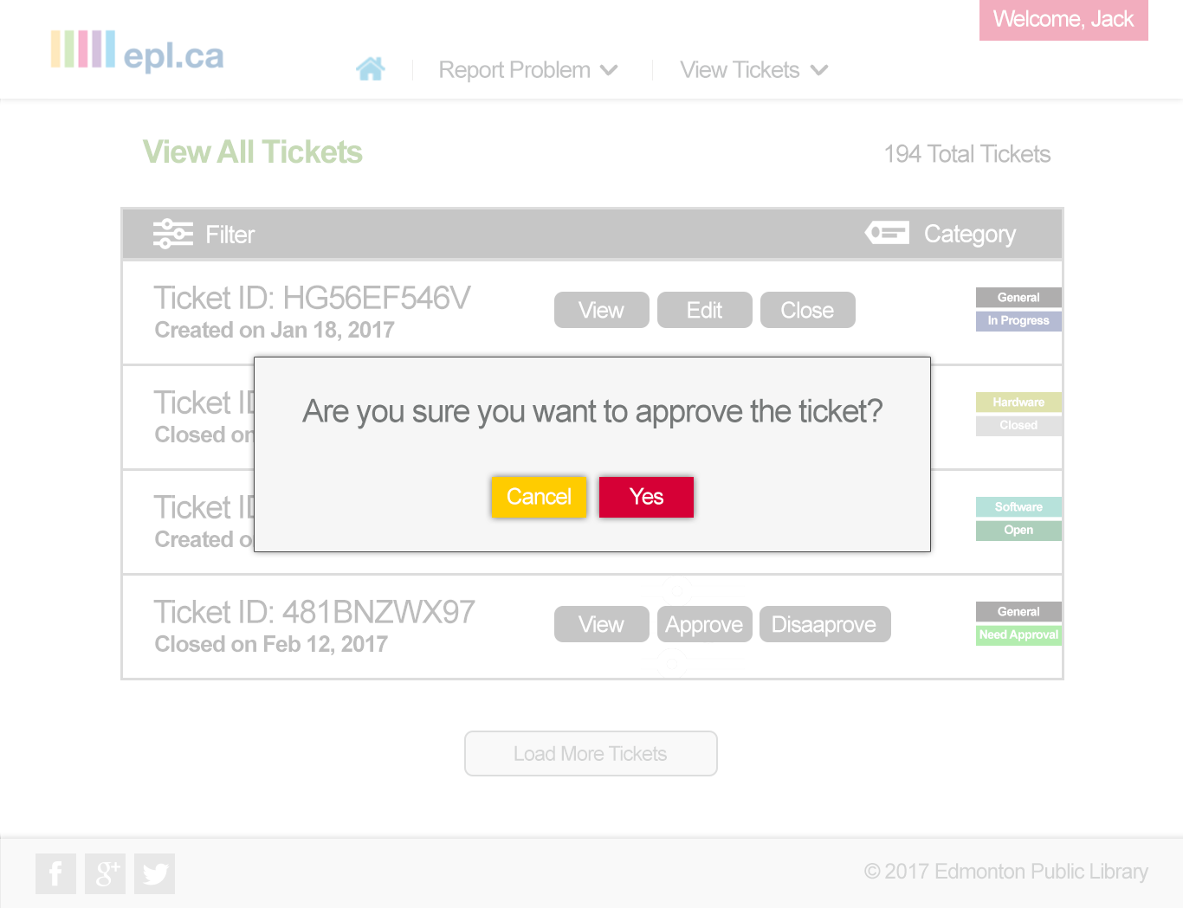

Slide 51
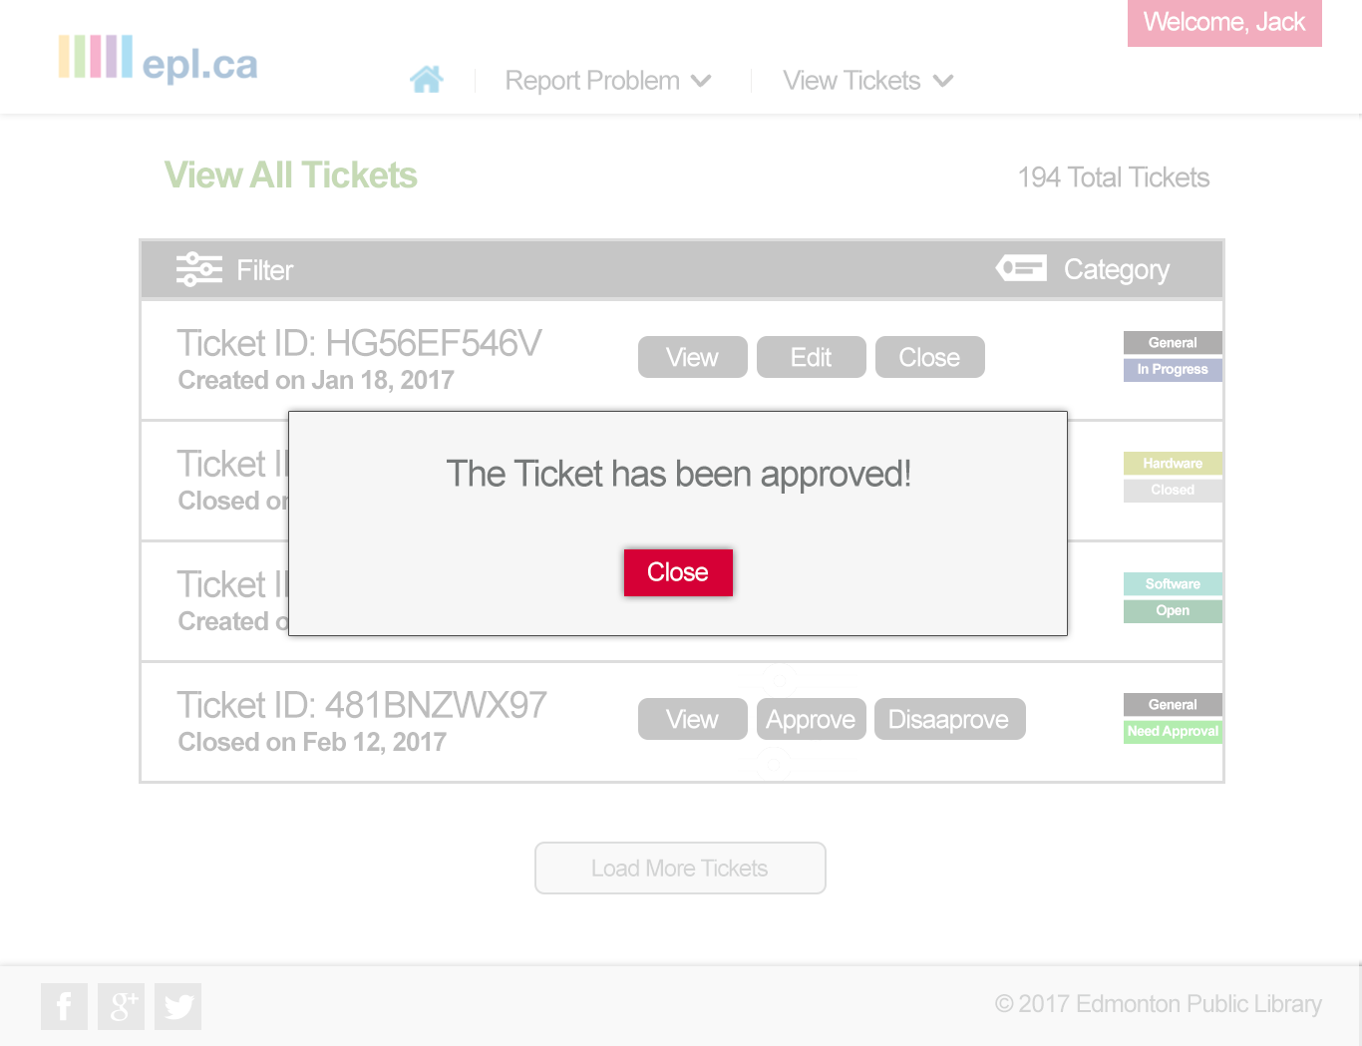

Slide 52
CONCLUSION
Summarization of the presentation

Slide 53
THE END
End of the presentation
Any Questions, Feedback or Suggestions?

Slide 54
ASK VICKY
Questions to ask Vicky

Slide 55
RESET USERNAME
Do we need to have an option for resetting usernames, in case a user forgets their username?

Slide 56
TICKET ADDRESSES
Would there be tickets that could be addressed to departments other than IT?

Slide 57
BRANCH MANAGER
What are the authorizations that a branch manager should have?

Slide 58
TEAM ASSIGNMENT
How should the system handle multiple technicians working on a single ticket? Should one technician be allowed to choose a ticket for a team?

Slide 59
ANONYMOUS TICKETS
Should the ticket submitter and the technician working on the ticket automatically be known to one another?

Slide 60
IT'S THE END END
THE END

